Slide 1
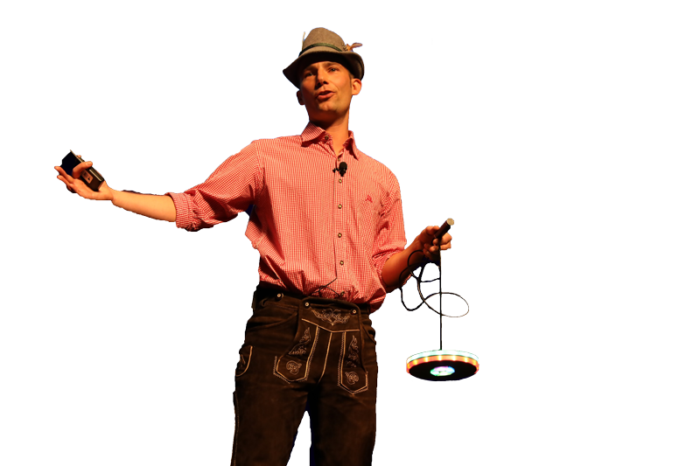






Building an Unbreakable Delivery Pipeline Shift-Left, Shift-Right, Self-Healing / Auto-Remediation Based on: https://github.com/Dynatrace/AWSDevOpsTutorial
Followed by live Q&A:
Part of: http://bit.ly/onlineperfclinic
Get Dynatrace SaaS Trial: http://bit.ly/dtsaastrial
Listen to PurePerformance: http://bit.ly/pureperf
Andreas Grabner, Dynatrace @grabnerandi

Slide 2












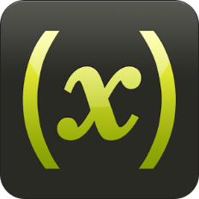




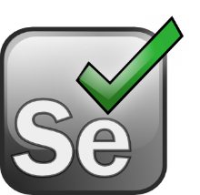










Shift-Left: Break Pipeline Earlier
Shift-Right: Tags, Deploys, Events
Dev
Perf/Test
Ops
Biz
Actionable Feedback Loops
Path to NoOps: Self-Healing, …
Notes:
But there is more than production! There is more we can do throughout the whole DevOps Toolchain

Slide 3
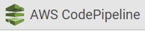
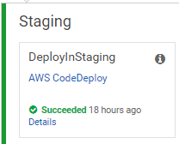
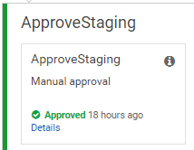
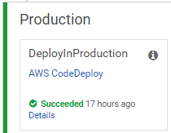
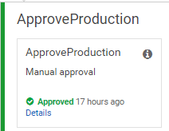







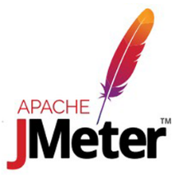

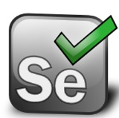
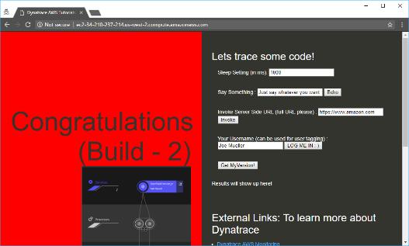
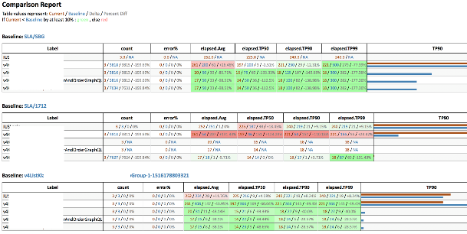
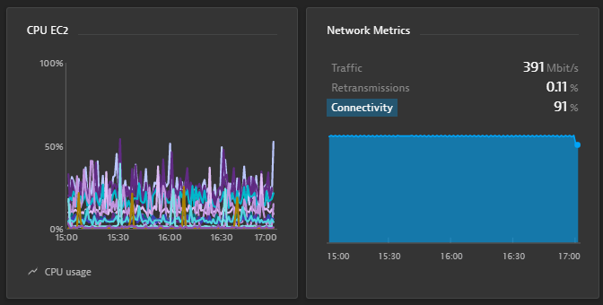
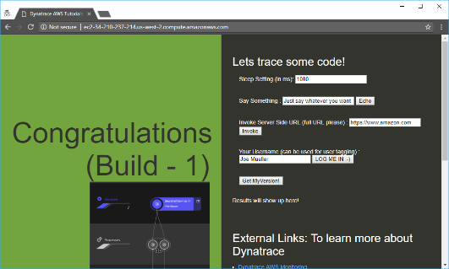
https://github.com/Dynatrace/AWSDevOpsTutorial
AppTeam
Users
AWS CodeDeploy
AWS CodeDeploy
Manual Approval
Manual Approval
Manual Rollback
AWS EC2
AWS EC2

Slide 4
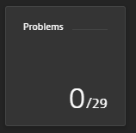
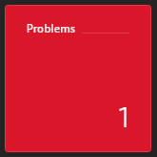

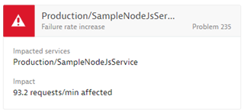
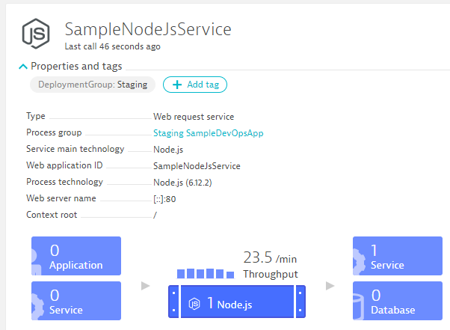
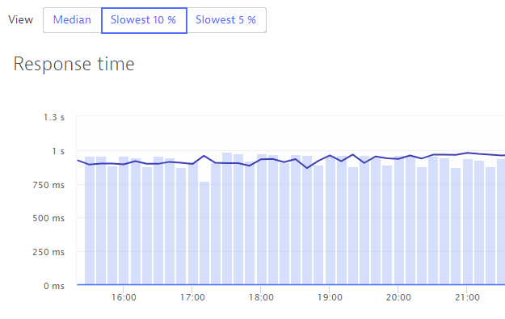
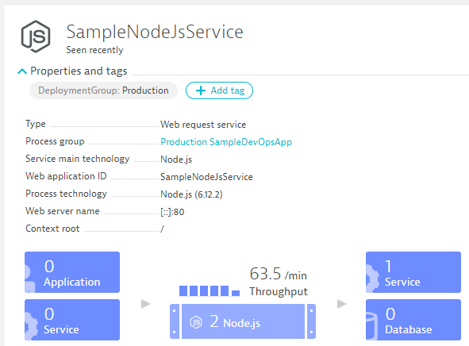
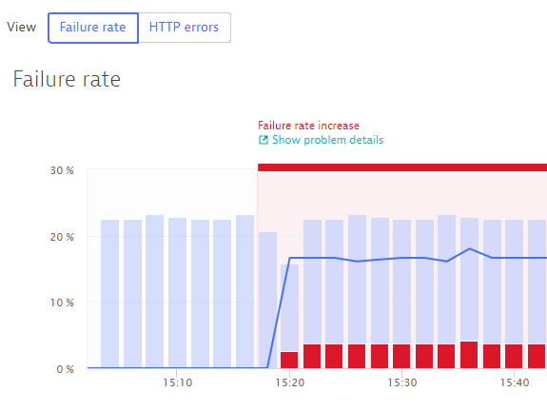

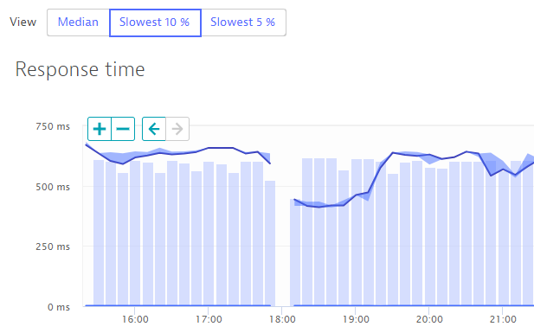
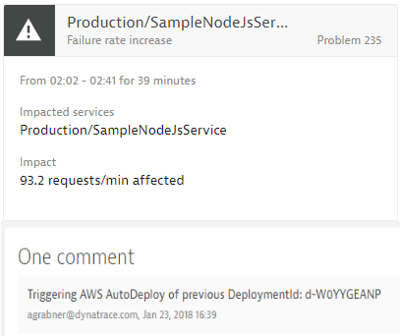
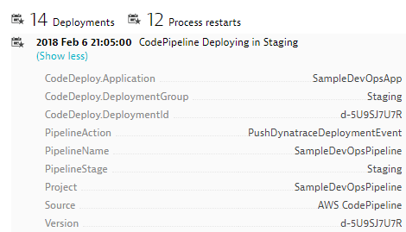
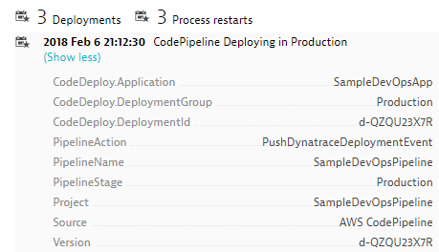
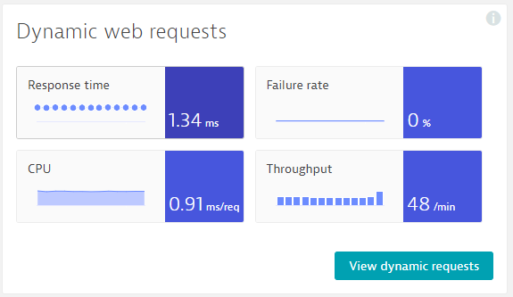
https://github.com/Dynatrace/AWSDevOpsTutorial
Self-Healed
Auto-Approve!
Auto-Approve!
Auto-Reject!
Auto-Reject!
pushDynatraceDeploymentEvent
Pushes Deployment Info to Dynatrace Entities
validateBuildDynatraceWorker
Compares Builds and Approves/Rejects Pipeline
pushDynatraceDeploymentEvent
Pushes Deployment Info to Dynatrace Entities
validateBuildDynatraceWorker
Validates Production and Approves/Rejects Pipeline
Build 6
Production
handleDynatraceProblemNotification
Executes Auto-Remediating Actions, e.g: Rollback
Build 7
Production

Slide 5
LIVE DEMO!! Getting Started with the Tutorial

Slide 6
Behind the Scenes: Deployment Shift-Right: Version Information, Tags, Meta Data, …

Slide 7
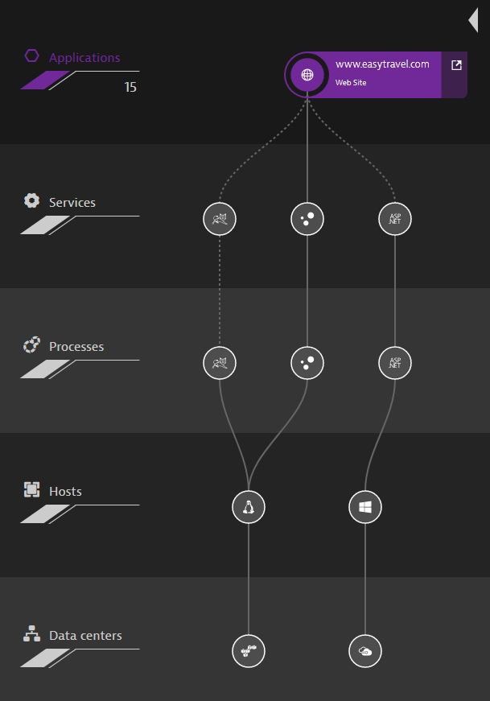

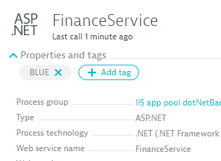


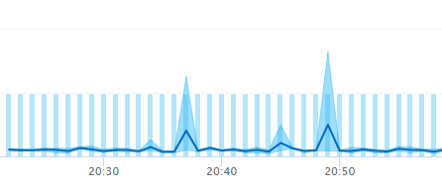


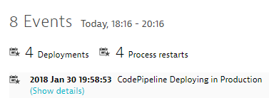

Shift-Right: Tags, Deployments & Events
Release
Automation
Dynatrace Automation
API, CLI, Auto-Detection
Dynatrace Smartscape
docker run –e DT_TAGS=BLUE
dtcli tag srv CartServicev2 GREEN
dtcli evt push pg tomcat1 desc=JVMMemIncr hint=+100MB
dtcli evt push host .*demo version=123 source={code_deploy}

Slide 8
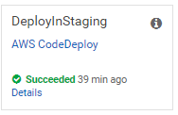
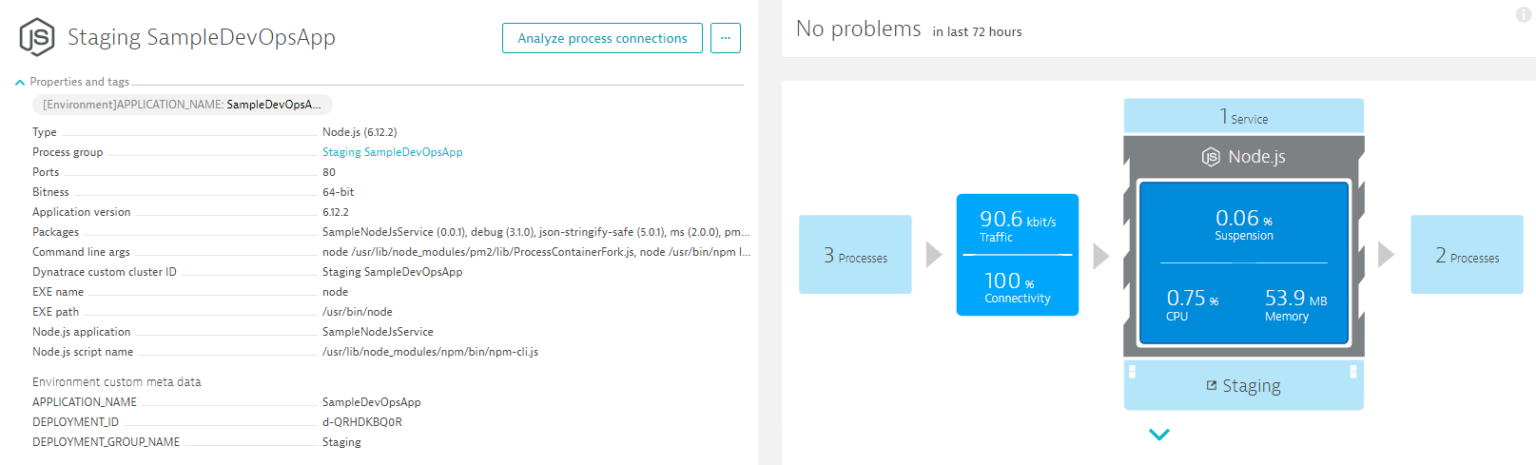
@ Deployment: Passing Meta Data to launched processes
AWS CodeDeploy executes script during deployment:
export DT_TAGS=APPLICATION_NAME=$APPLICATION_NAME
export DT_CUSTOM_PROP="DEPLOYMENT_ID=$DEPLOYMENT_ID DEPLOYMENT_GROUP_NAME=$DEPLOYMENT_GROUP_NAME APPLICATION_NAME=$APPLICATION_NAME“
export DT_CLUSTER_ID="$DEPLOYMENT_GROUP_NAME $APPLICATION_NAME“
pm2 start app.js &> pm2start.log
#2 DT_CLUSTER_ID
#2 DT_TAGS
#2 DT_CUSTOM_PROP

Slide 9
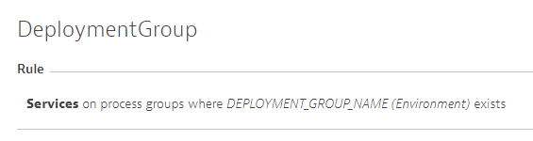
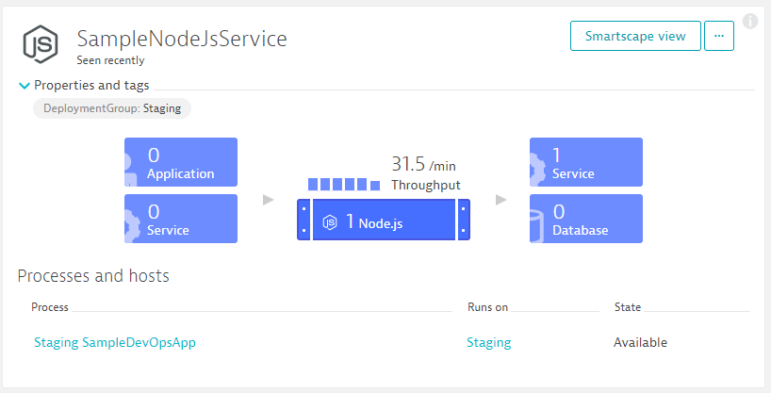
@ Deployment: Converting Process Meta Data to Tags on Services!
Via Tagging Rule

Slide 10
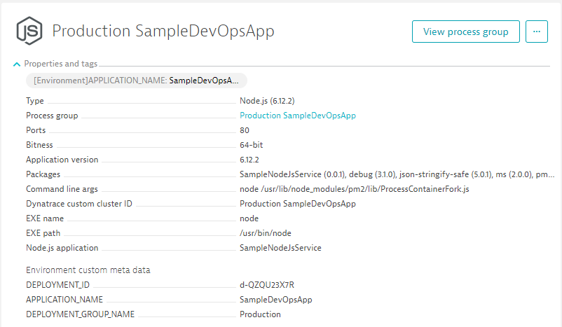
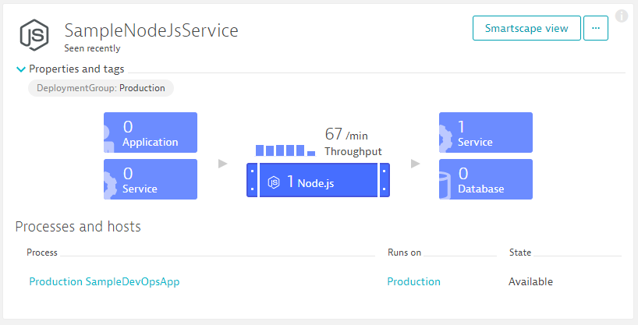
@ Deployment: Converting Process Meta Data to Tags on Services!
Via Tagging Rule

Slide 11
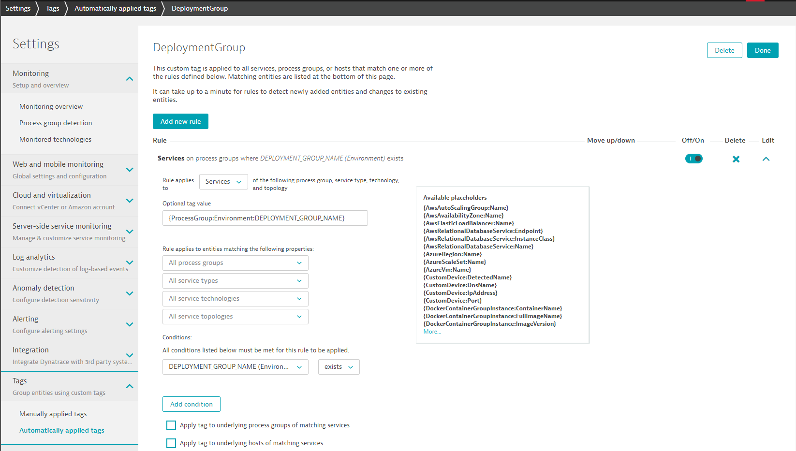
Automated Tag Rules: Define ONCE in Dynatrace!
#2 – Call the Tag “DeploymentGroup”
#3 – For Services
#4– Tag Value comes from our Process Environment Variable
#5 – Only apply rule if env variable exists
#1

Slide 12
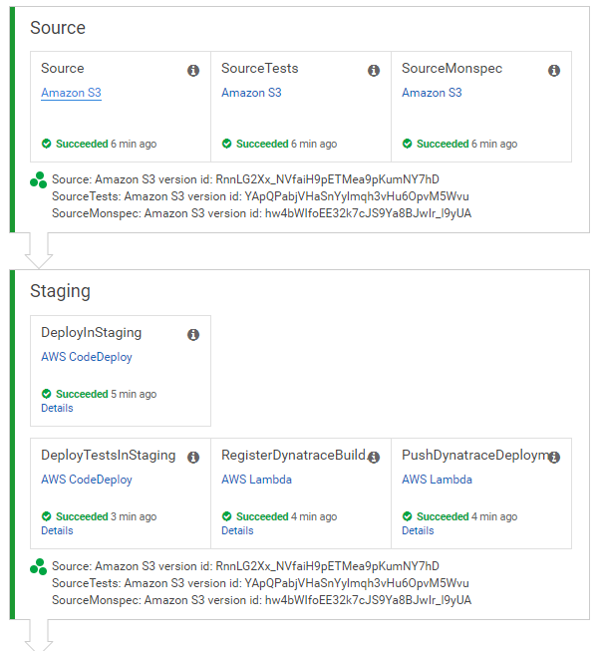
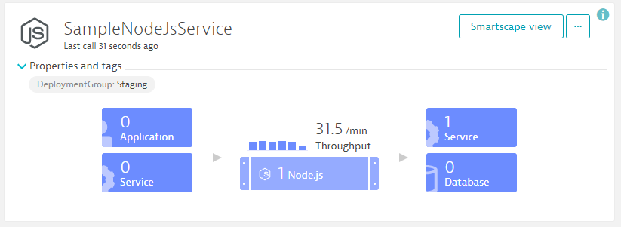
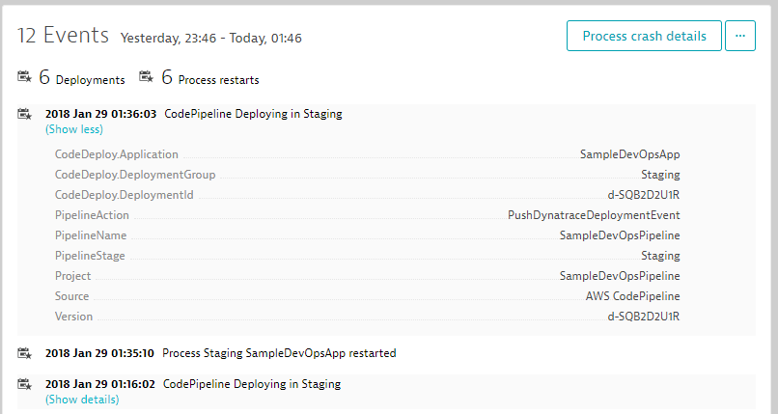

@Deployment: Pass Deployment Information to Deployed Entities
+ CodeDeploy Information from same Stage
Dynatrace Events REST API
pushDynatraceDeploymentEvent
Pushes CodePipeline Info to Dynatrace

Slide 13
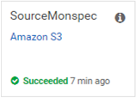
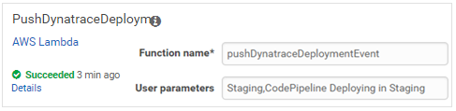
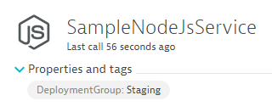
Monitoring as Code (Monspec): Define Services and their Environments as Code
Monspec (Monitoring as Code)
"SampleJSonService" : {
"etype": "SERVICE",
"environments" : {
"Staging" : {
"tags" : [
{
"context": "CONTEXTLESS",
"key": "DeploymentGroup",
"value": "Staging"
}
]
},
"Production" : {
"tags" : [
{
"context": "CONTEXTLESS",
"key": "DeploymentGroup",
"value": "Production"
}
]
}
},
pushDynatraceDeploymentEvent
Pulls Tag Information from Monspec
Dynatrace Events REST API
Pushes Event for Entities with Tag DeploymentGroup:Staging

Slide 14
Behind the Scenes: Approval Stage Shift-Left: Automate Metric Comparison to Validate Build

Slide 15
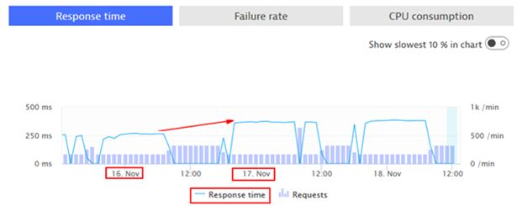
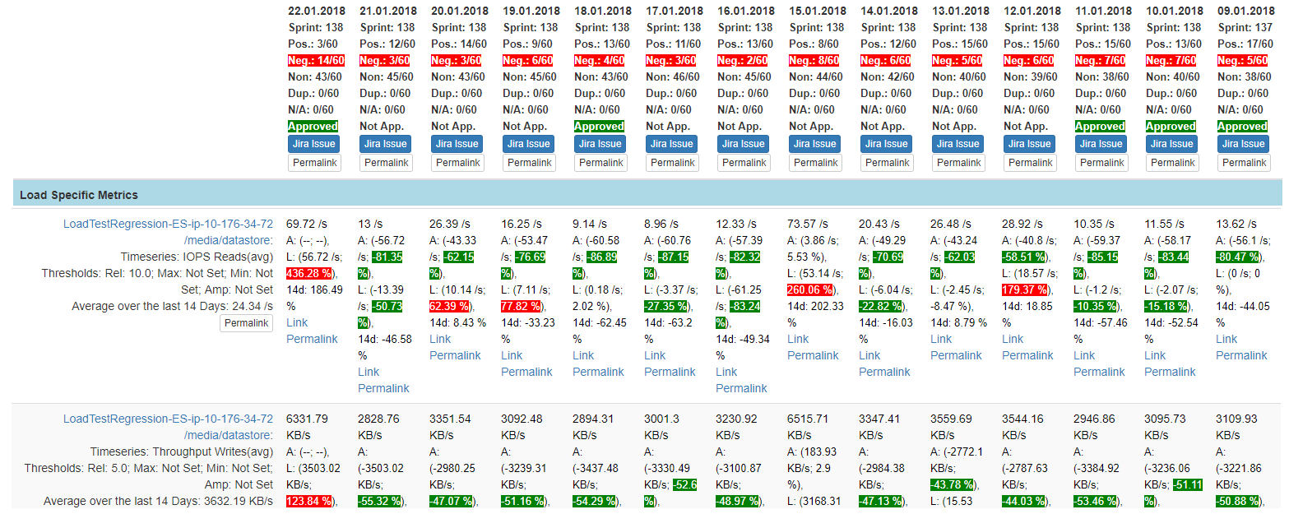
Inspired by Continuous Performance Teams @ Dynatrace, Intuit, REI, PayPal …
“Performance Signature” for Build Nov 16
“Performance Signature” for Build Nov 17
“Performance Signature” for every Build
“Multiple Metrics” compared to prev Timeframe
Simple Regression Detection
per Metric

Slide 16
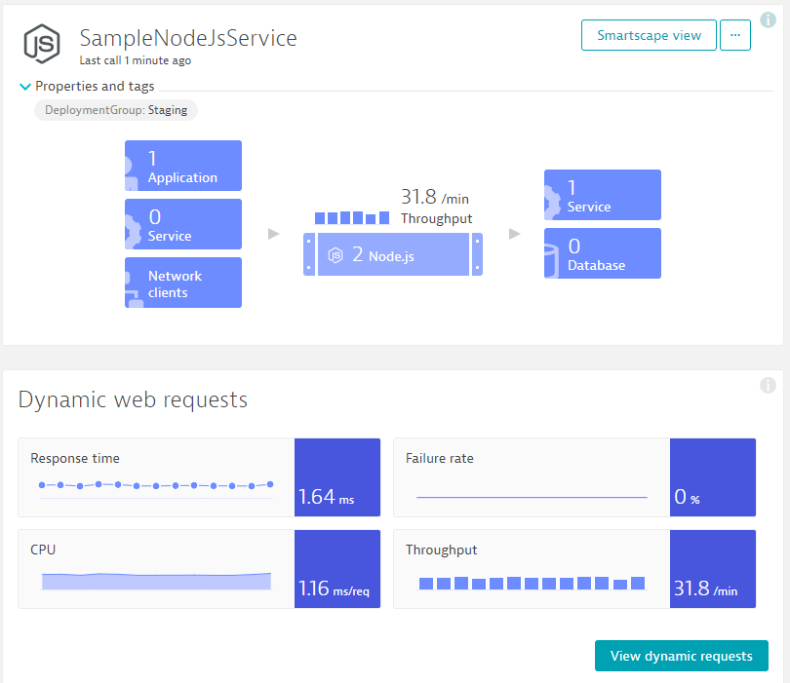
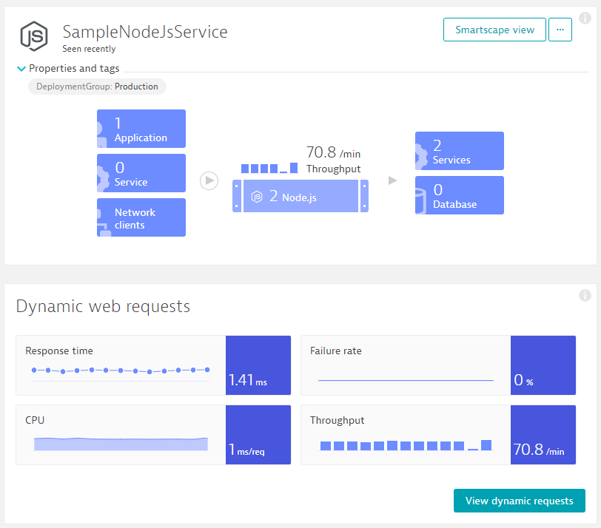
Monitoring as Code: Compare Metrics of Services of Different Environments/Builds
Entity: SampleJSonService
Different Metrics
Environment: Staging
Tag: DeploymentGroup:Staging
Environment: Production
Tag: DeploymentGroup:Production
Metrics: ResponseTime (Avg)
Metrics: ResponseTime(Max) < 10s
Metrics: FailureRate(Avg)
Metrics: ResponseCount
Factor: 90% Less vs Production
Different Comparisons
Compare: StagingToProduction
Source: Staging; Compare: Prod
Factor: Staging = 10% Slower
Compare: StagingToProdYesterday
Source: Staging; Compare: Prod
Factor: 10%, Timeshift: 86400s
Compare: StagingToStagingLastHour
Source: Staging; Compare: Staging
Factor: 0; Timeshift: 3600s
Compare: StageToStageYesterday
Source: Staging; Compare: Staging
Factor: 0; Timeshift: 86400s
Pipeline Run: Validate Build with StagingToProduction
Source (Staging): 1.64ms
Environment: Staging
Environment: Production
Compare (Production): 1.41ms
Threshold (+10%): 1.56ms
Status: VIOLATION

Slide 17
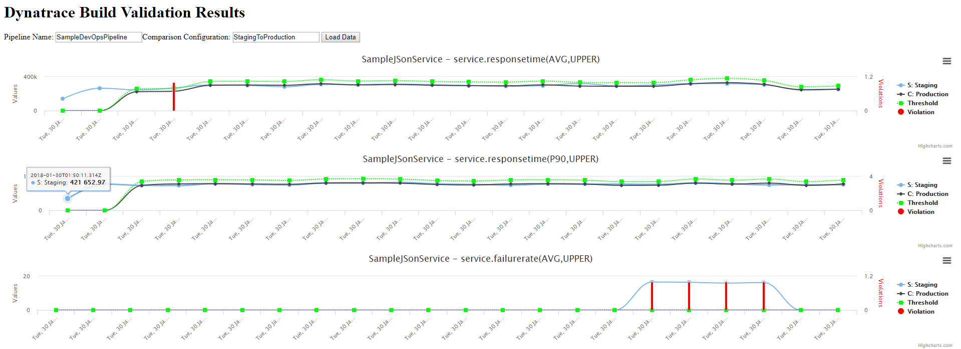
Automate the Comparison: Trigger it for each Build and keep track of status!
Comparisons
Entity
Metrics
Environment
Good Build
Good Build
Good Build
Bad Build
Bad Build
Bad Build
Good Build
Bad Build

Slide 18
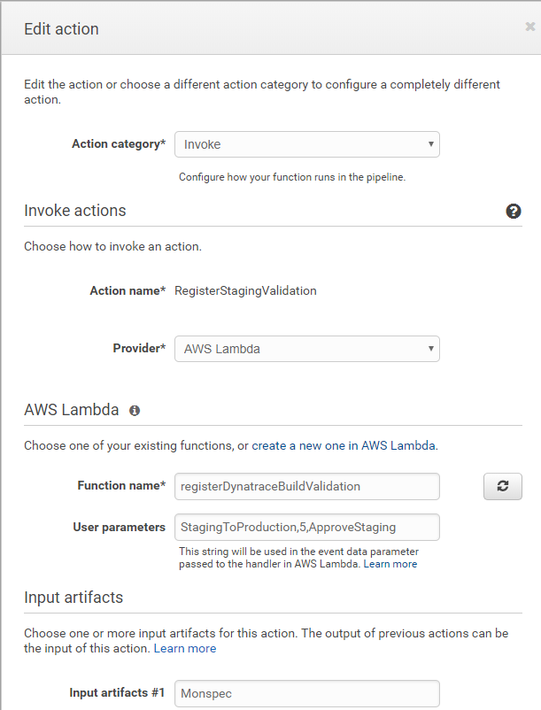
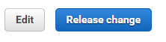

@Approval: Automating Build Validation into your CodePipeline
Invoke
RegisterStagingValidation
AWS Lambda
registerDynatraceBuildValidation
StagingToProduction,5,ApproveStaging
Monspec

Slide 19




@Approval: Automating Build Validation into your CodePipeline
Monspec from S3
Build Validation Request Item
Pipeline Information
Monspec
Timestamp + Timeframe
Comparison Definition Name
Action Name to Approve / Reject
Staging: Register Build Validation!
Adds Item
registerDynatraceBuildValidation
Adds Build Validation Request
Updates Build Validation Request
Updated Monspec
Updated Status
Approves/Rejects IF “In Progress” & if RegisterBuildValidation was called with that Action Name
triggers
validateBuildDynatraceWork
CloudWatch Events
(e.g: 1min)
Dynatrace Entities & Timeseries REST API
Resolves Tags and gets list of Entities
Queries Metrics for these Entities

Slide 20


@Approval: Automating Build Validation into your CodePipeline

Slide 21

@Approval: Automating Build Validation into your CodePipeline
Open in Browser: http://YOURAPIGATEWAY.amazonaws.com/v1/BuildValidationResults

Slide 22
Monitoring as Code: The Full Picture
monspec.json
{
"SampleJSonService" : {
"etype": "SERVICE", // "Options are SERVICE, APPLICATION, HOST, PROCESS_GROUP_INSTANCE"
"name": "SampleNodeJsService",
"environments" : {
"Staging" : {
"tags" : [
{
"context": "CONTEXTLESS",
"key": "DeploymentGroup",
"value": "Staging"
}
]
},
"Production" : {
"tags" : [
{
"context": "CONTEXTLESS",
"key": "DeploymentGroup",
"value": "Production"
}
]
}
},
Entity: What Entity do we want to validate?
Environments: Tell us how we can detect these entities in Dynatrace

Slide 23
Monitoring as Code: The Full Picture
Comparision: Which environments do we compare and how!
monspec.json
{
"SampleJSonService" : {
...
"comparisons" : [
{
"name" : "StagingToProduction",
"source" : "Staging",
"compare" : "Production",
"scalefactorperc" : {
"default": 10,
"com.dynatrace.builtin:service.requestspermin" : 90
},
"shiftcomparetimeframe" : 0,
"shiftsourcetimeframe" : 0,
},
{
"name" : "StagingToProductionYesterday",
"source" : "Staging",
"compare" : "Production",
"scalefactorperc" : {
"default": 10,
"com.dynatrace.builtin:service.requestspermin" : 90
},
"shiftsourcetimeframe" : 0,
"shiftcomparetimeframe" : 86400
}
monspec.json
{
"SampleJSonService" : {
...
"comparisons" : [
{
"name" : "StagingToStagingLastHour",
"source" : "Staging",
"compare" : "Staging",
"scalefactorperc" : { "default": 0},
"shiftsourcetimeframe" : 0,
"shiftcomparetimeframe" : 3600
},
{
"name" : "ProductionToProductionLastH",
"source" : "Production",
"compare" : "Production",
"scalefactorperc" : { "default": 0},
"shiftsourcetimeframe" : 0,
"shiftcomparetimeframe" : 3600
}
],

Slide 24
Monitoring as Code: The Full Picture
monspec.json
{
"SampleJSonService" : {
...
"perfsignature" : [
{
"timeseries" : "com.dynatrace.builtin:service.responsetime",
"aggregate" : "avg", // min, max, avg, sum, median, count, percentile
"validate" : "upper", // upper or lower
// "upperlimit" : 100, // Optional: Can be used to define a FIXED THRESHOLD
// "lowerlimit" : 50, // Optional: Can be used to define a FIXED THRESHOLD
},
{
"timeseries" : "com.dynatrace.builtin:service.responsetime",
"aggregate" : “p90"
},
{
"timeseries" : "com.dynatrace.builtin:service.failurerate",
"aggregate" : "avg"
},
{
"timeseries" : "com.dynatrace.builtin:service.requestspermin",
"aggregate" : "count",
“validate" : "lower"
}
],
Metrics: Which Metrics, Aggregation, Upper/Lower Boundaries

Slide 25
Behind the Scenes: Self-Healing Smart Remediation Action based on AI-Detected Problems

Slide 26











Path to NoOps: Better and Smarter Auto-Remediation, Self-Healing, …
?Escalate at 2AM?
…
Auto Mitigate!
…
?
1
CPU Exhausted? Add a new service instance!
2
High Garbage Collection? Adjust/Revert Memory Settings!
4
3
Issue with BLUE only? Switch back to GREEN!
4
Hung threads? Restart Service!
Update Dev Tickets
3
?
Impact Mitigated?
2
Mark Bad Commits
5
Still ongoing? Initiate Rollback!
1
Escalate
5
?
Still ongoing?

Slide 27


Automated Rollbacks with AWS Lambda and AWS CodeDeploy
#1: Push Deployment Information, e.g: CodeDeploy DeploymentId
#3
Uses Dynatrace Events API
to pull CUSTOM_DEPLOYMENT events
#2: Calling Lambda via API Gateway
#4: Redeploy previous revision
handleDynatraceProblemNotification
#5: Push comment to Dynatrace

Slide 28
Simulating Different “Bad” Builds
Application looks for Env variable BUILD_NUMBER during startup. Allowed values, 1, 2, 3, 4
Build Number | Behavior
1 | No Problem
2 | 50% of requests return HTTP 500
3 | No Problem
4 | Staging OK. 10% Requests fail in Production
To Deploy a different build:
From appbuilds_readytodeploy\app_buildX.zip rename to app.zip
Upload app.zip and overwrite existing app.zip in your S3 bucket
In your AWS CodePipeline click on “Release change”

Slide 29
Additional Features to Explore Service Naming Rules, Log Based Events, …

Slide 30


Additional Features to Explore: Nicer Service Names

Slide 31

Service Naming Rules: Distinguish services between Staging and Production
#2
#3
DEPLOYMENT_GROUP_NAME/Detected ServiceName
#1
Only when DEPLOYMENT_GROUP_NAME exists

Slide 32

Log Rule Events: Automated Problem Detection based on custom Log Messages
#1 Define a Name
#2 Create Log Problem if we have more than 0 occurences
#3 Select log file from Production and Staging
#4 Save

Slide 33

Log Rule Events: Automated Problem Detection based on custom Log Messages
#1 Browse to /api/causeerror
That should open a problem ticket!

Slide 34
Additional Resources & Reminders
Get your Dynatrace SaaS or Managed Trial: http://bit.ly/dtsaastrial
Meetups, User Groups, Workshops: We are happy to present!
All listed here: https://www.dynatrace.com/company/events/
February: Montreal (QC), NYC Meetup, …
March: Atlanta (GA), Columbus (OH), Cincinnati (OH), BTOES, DevOps Days LA, …
April: Denver (CO), Minneapolis (MN), www.devone.at (Linz, Austria), …
Online Training Material
Dynatrace University: http://university.dynatrace.com
Dynatrace FullStack YouTube Playlist: http://bit.ly/oneagenttutorials
Dynatrace Coffee Breaks: http://dynatrace.ai/coffeebreak
Dynatrace Power Demos: https://www.dynatrace.com/demos/
Sample Applications, Tutorials & more
easyTravel: http://bit.ly/dteasytravel
AWS Tutorial w Sample Apps: https://github.com/Dynatrace/AWSMonitoringTutorials
Dynatrace CLI: https://github.com/Dynatrace/dynatrace-cli
PurePerformance Podcast: http://bit.ly/pureperf

